Slide 1

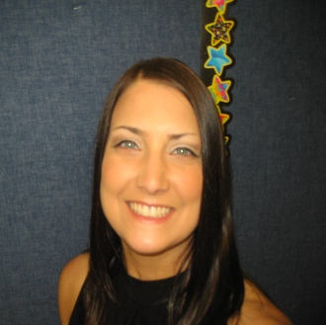
I’m Mrs. Pieloch!
I am thrilled that you will be in my class this year! Teaching is an absolute passion of mine! This is going to be my 22nd year teaching 1st grade at Whitehouse School, so I think that you can infer that I love First Grade! I think it is the best grade ever!
It is going to be a year full of FUN, learning, and lots of adventures. You are going to discover all about air and weather, story writing, and lots more! I cannot wait to see what the year has in store for us!
I hope that you had a fabulous summer. I sure did! I spent a lot of time with my family. It was a lot of fun taking my two little boys, Hudson and Kaden, on many adventures. Now, I’m super excited to meet you! The first day of school starts on Tuesday, September 2nd in room 121.
turquoise and lime green
summer
Italian and Mexican food
“Don’t Stop Believing” by Journey
skinny vanilla latte
any book by Mo Willems
ice hockey and lacrosse

